Slide 1


CE-QUAL-W2 Model Grid
UNCLASSIFIED
Lauren Melendez
U.S. Army Engineer Research and Development Center, Environmental Laboratory
CE-QUAL-W2 Workshop
July 08 – 09, 2024
Environmental Systems
Modeling Team
UNCLASSIFIED

Slide 2
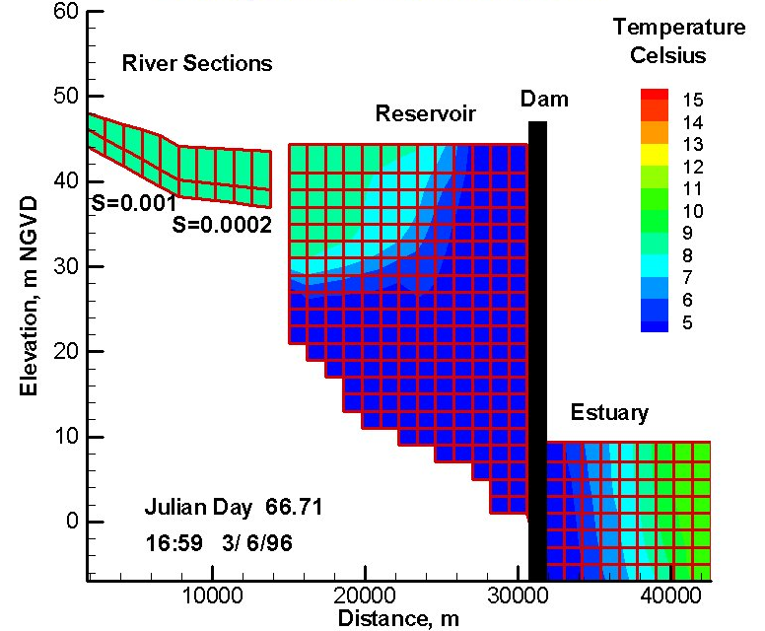
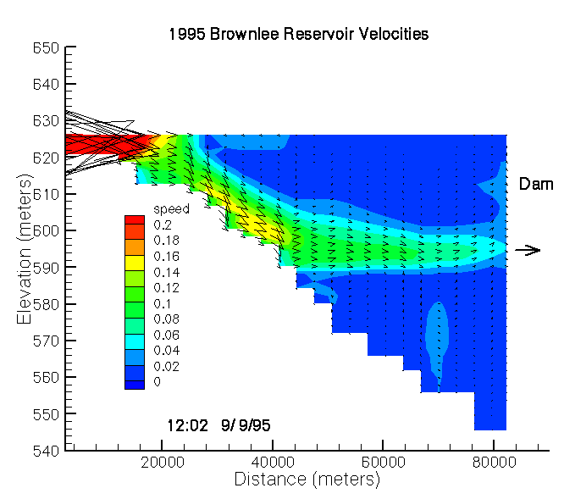
Computational Grid
The computational grid is the finite difference representation of the waterbody. The grid geometry is defined by:
Longitudinal spacing (segment length): DLX
Vertical spacing (layer height): H
Average cross-sectional width (cell width): B
Waterbody slope: SLOPE
The longitudinal and vertical spacing may vary from segment to segment and layer to layer, but the spacing should vary gradually from one segment or layer to the next to minimize discretization errors.

Slide 3
Computational Grid
Front View
(Looking Upstream)
Top View
The computational grid is the finite difference representation of the waterbody. The grid geometry is defined by:
Longitudinal spacing (segment length): DLX
Vertical spacing (layer height): H
Average cross-sectional width (cell width): B
Waterbody slope: SLOPE
The longitudinal and vertical spacing may vary from segment to segment and layer to layer, but the spacing should vary gradually from one segment or layer to the next to minimize discretization errors.
Side View
East Canyon Reservoir W2 Bathymetry (plan, profile, and cross section views)

Slide 4

Geometric Data
The following data are needed to set up the Geometry:
Elevation Data
Topographic map
Digital Elevation Map (DEM)
Sediment range surveys
Volume-Area-Elevation Table

Slide 5
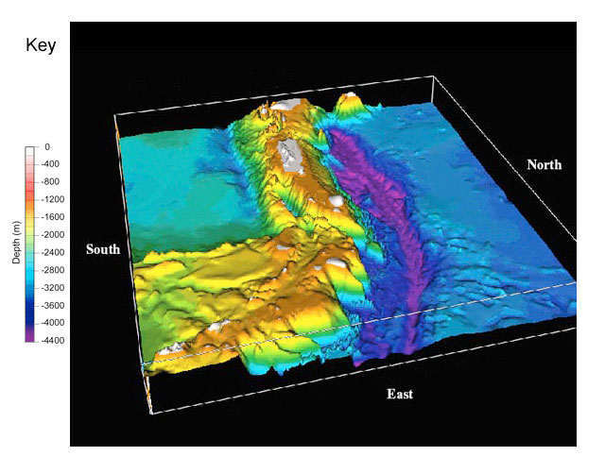
Factors Affecting the Computational Grid
Areas of strongest gradients
Computational and memory requirements
Bottom slope
Results

Slide 6
Sample Computational Grid
A sample computational grid in the longitudinal/vertical plane with four branches is shown here.
The grid consists of 25 longitudinal segments [IMX] and 22 vertical layers [KMX].
They constitute the total number of cells in the computational grid.
This is exactly how the model sees the grid layout even though this is not the correct physical representation of the system.
Branch 2 and Branch 3 join Branch 1.

Slide 7
Grid Cell Types
Grid cell types. This grid contains two kinds of cells: ones with either a single or a double line border.
Cells with a single line border represent cells that may contain water during the simulation.
The active cells are defined in the bathymetry input as having non-zero widths.
Cells with a double border represent boundary cells located at or beyond the waterbody boundaries. The boundary cells are defined in the bathymetry input as having zero widths.

Slide 8
Grid Cell Types
There are four types of boundary cells:
Top
Bottom
Upstream
Downstream
Each segment must have a zero width for the cell in layer 1 and a zero width for every cell located below the bottom active cell.
For example, cells 1 and 12-22 in Segment 5 would have zero widths.
Each branch must have zero widths for upstream boundary and downstream boundary segments. This results in two segments of boundary cells between each branch (segments 10-11 and 16-17).

Slide 9
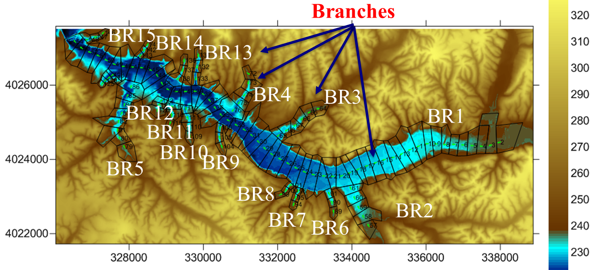
Branches
CE-QUAL-W2 can simulate a system with any number of waterbodies containing any number of branches.
This figure shows a plan view of the same three branch grid shown in the previous slides.
For each branch, the upstream segment [US] and the downstream segment [DS] must be defined.
The current upstream segment [CUS] is calculated by the model and may vary over time to meet restrictions imposed by the solution scheme.
Typically segment numbers increase going from upstream to downstream in the branch.
A branch may connect to other branches at its upstream [UHS] and/or downstream segment [DHS].
The downstream segment of branch 2 ([DS]=15) connects to branch 1 at segment 7 ([DHS]=7).

Slide 10
Grid Restrictions
The grid must satisfy the conditions:
Cell widths cannot increase with depth.
A branch may connect to other branches at its upstream or downstream segment, but a branch may not enter or leave itself.
Two branches may not connect at the same segment of another branch.
The bathymetry input file contains the longitudinal grid spacing [DLX], initial water surface elevation [WSEL], segment orientations [PHI0], vertical grid spacing [H], bottom friction [FRICT], and average cell widths [B].
East Canyon Reservoir W2 Bathymetry (plan, profile, and cross section views)

Slide 11
Grid Restrictions
After the bathymetry is generated, it should be checked to ensure the bottom elevation varies smoothly and represents the average slope over appropriate portions of the waterbody for reservoirs and estuaries.
Minimum bottom widths are often set at 5-15 m.
This helps increase timesteps with minimal impact on the volume-area-elevation curves.
However, increasing widths in the bottom layers can affect water quality since sediment oxygen demand and nutrient fluxes are dependent on bottom surface areas.
Refer to the bathymetry file and preprocessor output in the sample applications for additional guidance in setting up the bathymetry.
East Canyon Reservoir W2 Bathymetry (plan, profile, and cross section views)

Slide 12
Bathymetry File
The bathymetry file(s) contains information specifying the:
Segment lengths
Water surface elevations
Segment orientations
Bottom friction
Layer heights for each segment
Average widths for each grid cell.

Slide 13
Bathymetry File Guidelines
It is recommended that the user numbers the branches starting with the mainstem as branch 1. The remaining branch numbers should be numbered consecutively starting with the most upstream branch and followed by the remaining branches as one moves down-stream.
Each branch is surrounded by a segment of boundary cells (cells with zero widths) on both the upstream and downstream ends. Note that this requirement results in two segments of zero widths between each branch.
Boundary cells must also be included at the top and bottom of each segment.

Slide 14
Bathymetry File Guidelines
Cell widths start at layer 1 and continue to the maximum number of layers [KMX]. The number of layers specified in this file must match the value of [KMX] in the control file.
Only cells that are potentially active have non-zero widths. The first layer, boundary segment cells, and cells below the reservoir bottom elevation at a given segment have zero widths.
A separate bathymetry file is required for each waterbody.
The segment angles are relative to N. Figure 31 shows an example of segment orientation.

Slide 15
Bathymetry Files: CSV Format
We recommend developing the bathymetry in Microsoft Excel and then saving as a Comma-Separated Value (CSV) file, with the values delimited by commas.
This requires inserting the “$” character as the first character of the first line.

Slide 16
Bathymetry: CSV Format

Slide 17
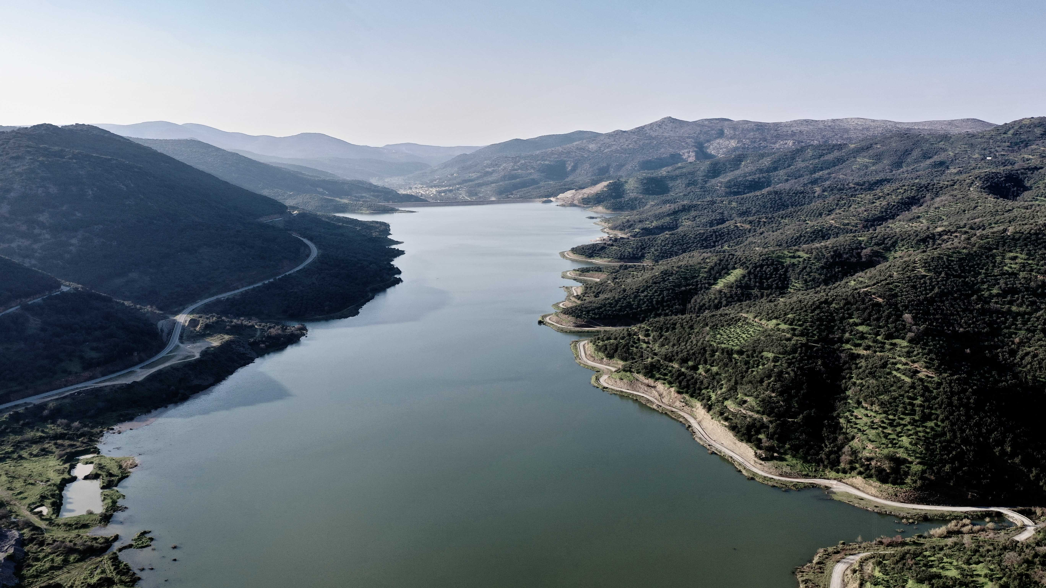
Bathymetry: Questions?

